Slide 1
COMPUTATIONAL ENRICHMENT ANALYSIS OF SAP PROTEIN ON LYSOSOMAL STORAGE DISORDER – METACHROMATIC LEUKODYSTROPHY
Guided by
Dr. Premnath D
Assistant Professor
Presented by
Antonita Racheal
URK17BI013

Slide 2
AIM AND OBJECTIVE
AIM:
To determine deleterious SAPs and perform comparative and structural analysis in the ARSA gene in patients with metachromatic leukodystrophy (MLD).
OBJECTIVE:
Identification of gene target and retrieval of SAP sequences from various data sources.
The retrieved dataset is validated and screened for identifying deleterious SAP’s using SNPs&GO based on Support Vector Machines (SVM).
The Selected Protein is Modelled ,Validated and Mutated using various software’s.
Comparative Analysis is performed for both Native and Mutant protein.

Slide 3
INTRODUCTION
Lysosomal storage diseases are inherited metabolic diseases that are characterized by an abnormal build-up of various toxic materials in the body's cells as a result of enzyme deficiencies.
LSDs affect mostly children and they often die at a young age, many within a few months or years of birth.
Like other genetic disorders, individuals inherit lysosomal storage diseases from their parents.
Most of these disorders are autosomal recessively inherited such as Niemann–Pick disease, type C, but a few are X-linked recessively inherited, such as Fabry disease and Hunter syndrome.
No cures for lysosomal storage diseases are known, and treatment is mostly symptomatic, although bone marrow transplantation and enzyme replacement therapy (ERT) have been tried with some success

Slide 4
Methodology
Identification of gene target
Retrieval of SAP sequences from various data sources
Retrieved dataset is validated and screened for identifying deleterious SAP’s using SNPs&GO
Extraction of deleterious SAP’s only for modelling and mutating using SwissPDB
Mutated and native model goes through energy minimization process using YASARA
Single model analysis for native and mutant is obtained
End Results

Slide 5
RESULTS - OBJECTIVE 1 Identification of gene target

Slide 6
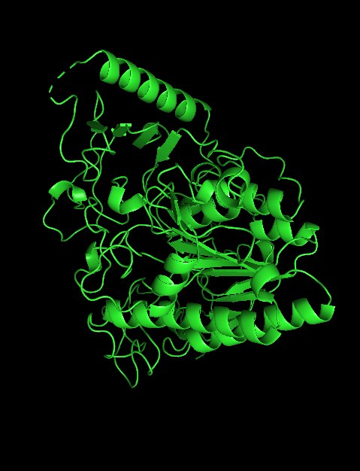
Metachromatic leukodystrophy
MLD is directly caused by a deficiency of the enzyme arylsulfatase A (ARSA).
Arylsulfatase A gene codes for ARSA enzyme.
MLD has an autosomal recessive inheritance pattern.
Crystal structure of an Arylsulfatase A
PDB: 1E33
Source: Homo sapiens
Resolution: 2.5 Å
Uniprot ID: P15289

Slide 7
OBJECTIVE 2 Retrieval of SAP sequences from various data sources

Slide 8
Mutations
Asian Indian - 2019
Novel Mutations
p180q q139k r299w g34e g392r
g127r f399s
Known Mutations
g156r r390w r311q t274m r299w
t304m d430y p426l f247c g293s
t272m r244h g309c r370w g245r
y33s
Sri Lankan - 2019
Novel Mutations
n350s y201h d281n r372q p84k
d283n r86w t393s r313q a344d
Know Mutations
R370Q
Egyptian - 2020
Novel Mutations
r60p v112d g124d p193s p276k
g311r p150l t276k g295s w195c
w320c n284s
Turkish - 2020
Novel Mutations
t276m a214p g311d w320c g298d
t393g i181s r301l r349w g247r
Chinese - 2020
Novel Mutation
r372q g298v g101v p194r l433v
g449r p84q
Italian - 2015
Known Mutations
c489g

Slide 9
OBJECTIVE 3 Retrieved dataset is validated and screened for identifying deleterious SAP’s using SNPs&GO

Slide 10
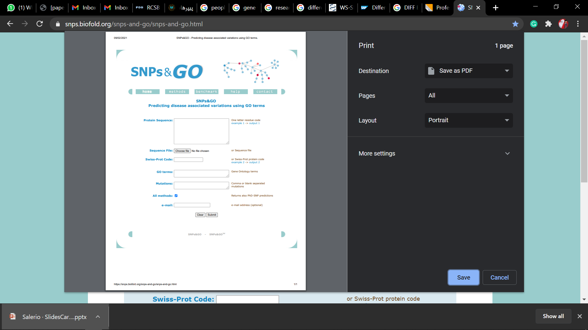

Slide 11
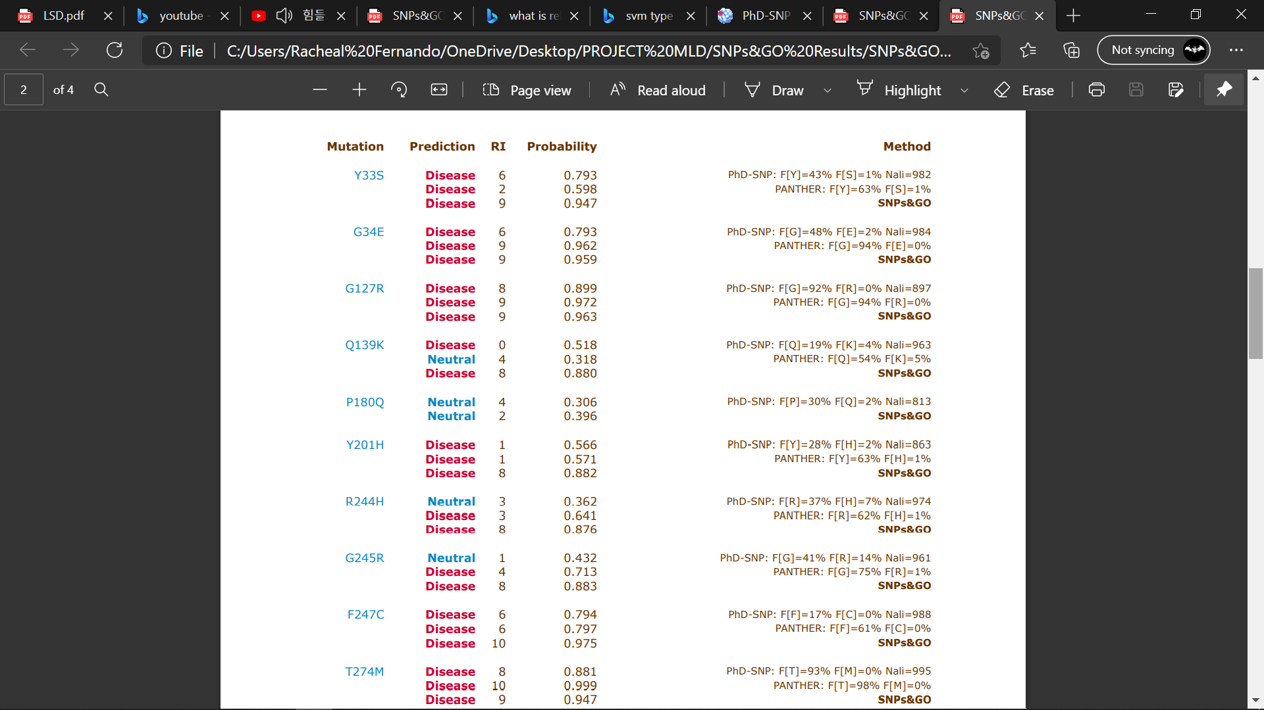

Slide 12
OBJECTIVE 4 Extraction of deleterious SAP’s for modelling and mutating using SwissPDB

Slide 13
Deleterious SAP
T274M
R311Q
R370W
R390W
C489G

Slide 14
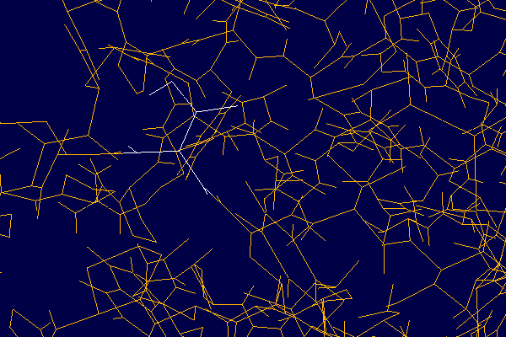
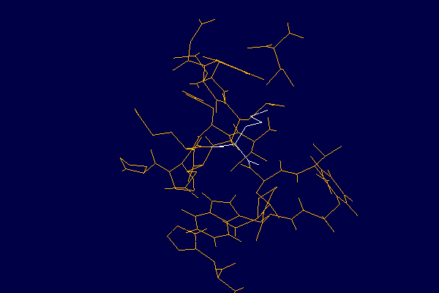
T274M
THREONINE274
METHIONINE274

Slide 15
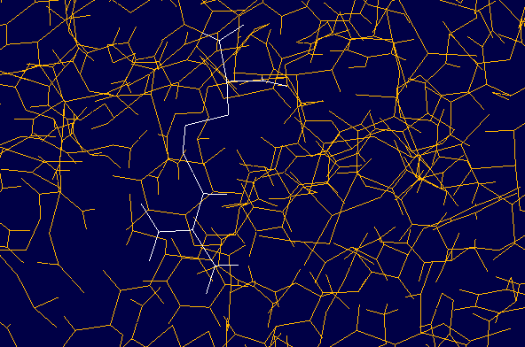
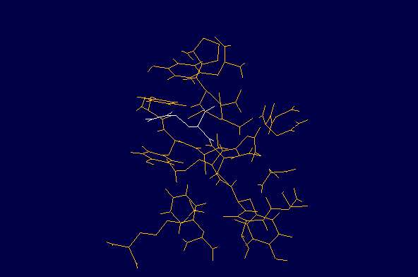
R311Q
ARGININE311
GLUETAMINE311

Slide 16
OBJECTIVE 5 Mutated and native model goes through energy minimization process using YASARA

Slide 17
RESULTS WITH ENERGY MINIMIZATION
Mutation | Prediction | PhD-SNP | PANTHER | RI | Probability | EM Native | EM Mutant
T274M | Disease | F[T]=93% F[M]=0% Nali=995 | F[T]=98% F[M]=0% | 9 | 0.947 | -86588.4 | -247354.6
R311Q | Disease | F[R]=92% F[Q]=0% Nali=992 | F[R]=94% F[Q]=0% | 9 | 0.929 | -87320.1 | -246171.2
R370W | Disease | F[R]=55% F[W]=0% Nali=949 | F[R]=62% F[W]=0% | 9 | 0.945 | -83025.2 | -248250.5
R390W | Disease | F[R]=81% F[W]=0% Nali=884 | F[R]=84% F[W]=0% | 9 | 0.958 | 72232953.4 | -247801.7
C489G | Disease | F[C]=66% F[G]=2% Nali=107 | F[C]=69% F[G]=2% | 9 | 0.946 | -67590.7 | -247130.3

Slide 18
OBJECTIVE 6 Single Model Analysis for the native and mutant compounds

Slide 19
SINGLE MODEL ANALYSIS
Intra-Molecular Interactions – Protein Interaction Calculator (PIC)
Secondary structure Analysis – PolyView MM
Contact Map Analysis – CM View
Fluctuation Analysis – CABS Flex
Solvent Accessible Surface Areas (SASA) – GETAREA

Slide 20
Intra-Molecular Interactions – Protein Interaction Calculator (PIC)

Slide 21
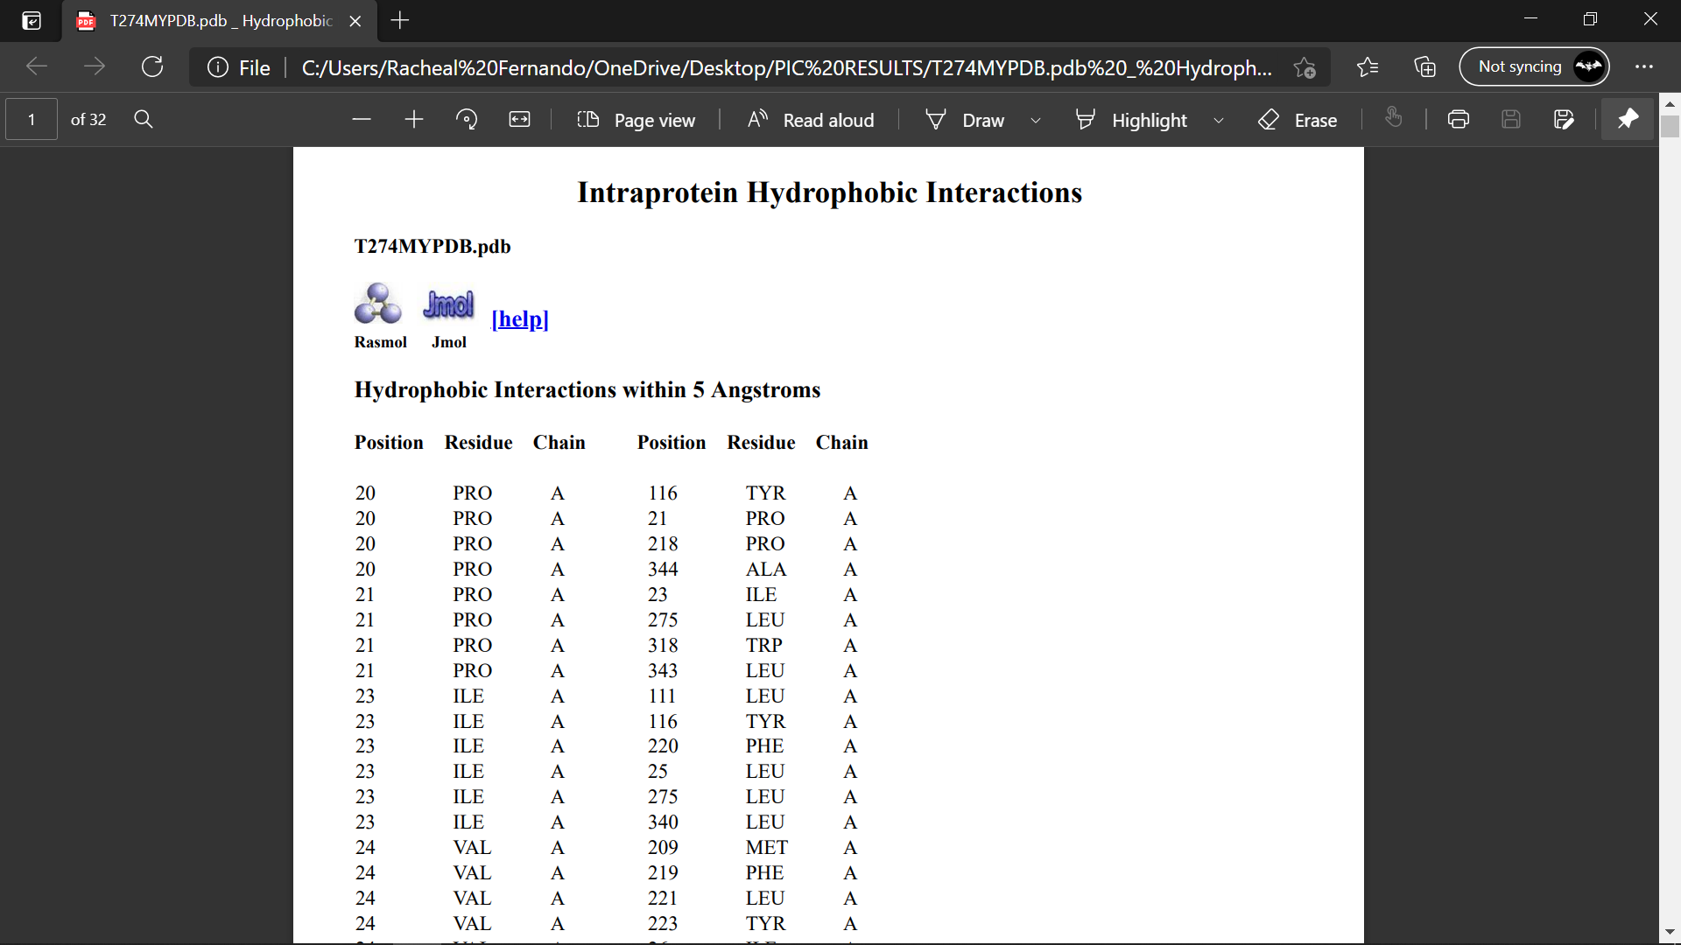
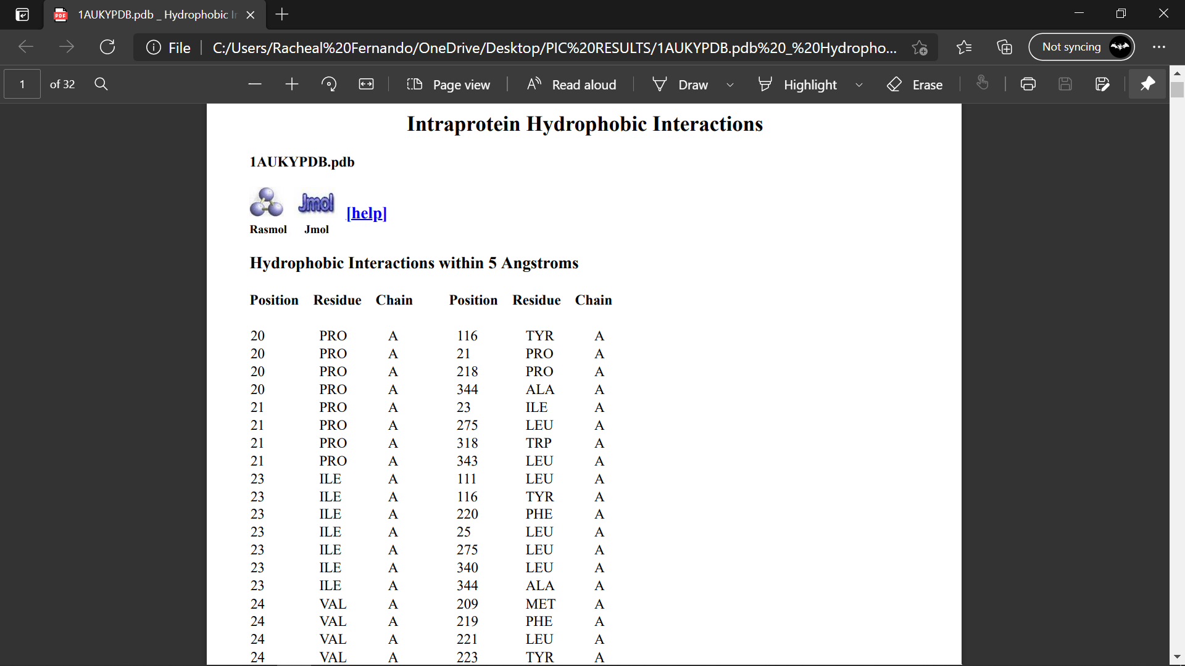

Slide 22
Intra-Molecular Interactions – Protein Interaction Calculator
Native and Mutants | Intraprotein Hydrophobic Interactions: Hydrophobic Interactions within 5 Angstroms | Intraprotein Disulphide Bridges Disulphide bridges: Between sulphur atoms of cysteines within 2.2 Angstroms | Intraprotein Main Chain-Main Chain Hydrogen Bonds | Intraprotein Main Chain-Side Chain Hydrogen Bonds | Intraprotein Side Chain-Side Chain Hydrogen Bonds
Native - 1AUK | 436 | 6 | 527 | 247 | 133
T274M | 442 | 6 | 533 | 235 | 148
R311Q | 430 | 6 | 519 | 254 | 141
R370W | 448 | 6 | 519 | 247 | 169
R390W | 444 | 6 | 520 | 238 | 139
C489G | 434 | 5 | 518 | 244 | 146

Slide 23
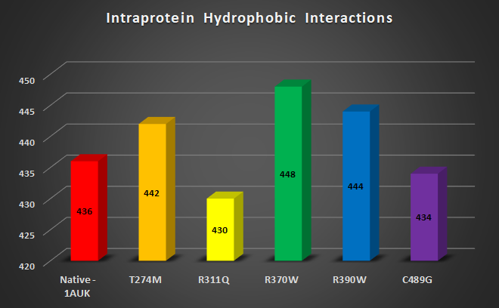

Slide 24
Secondary structure Analysis – POLYVIEW MM

Slide 25
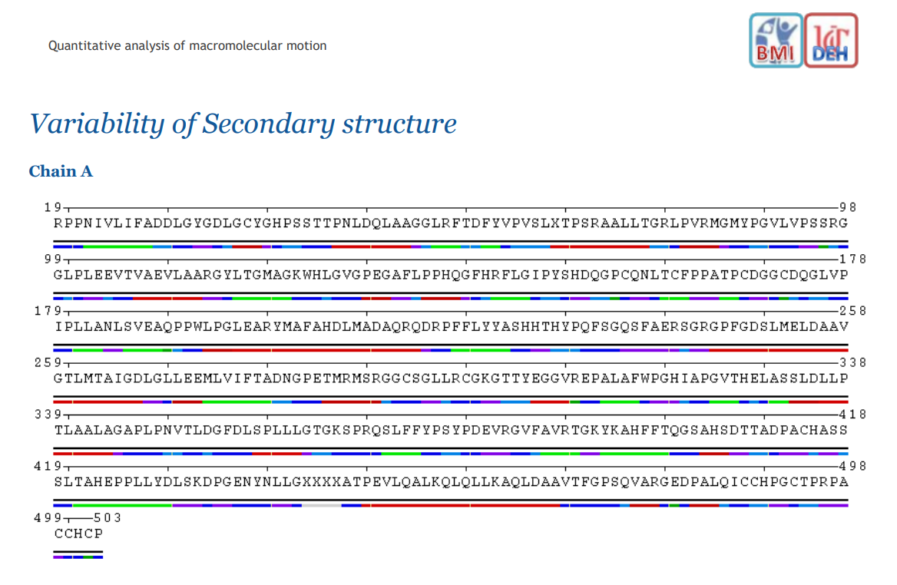
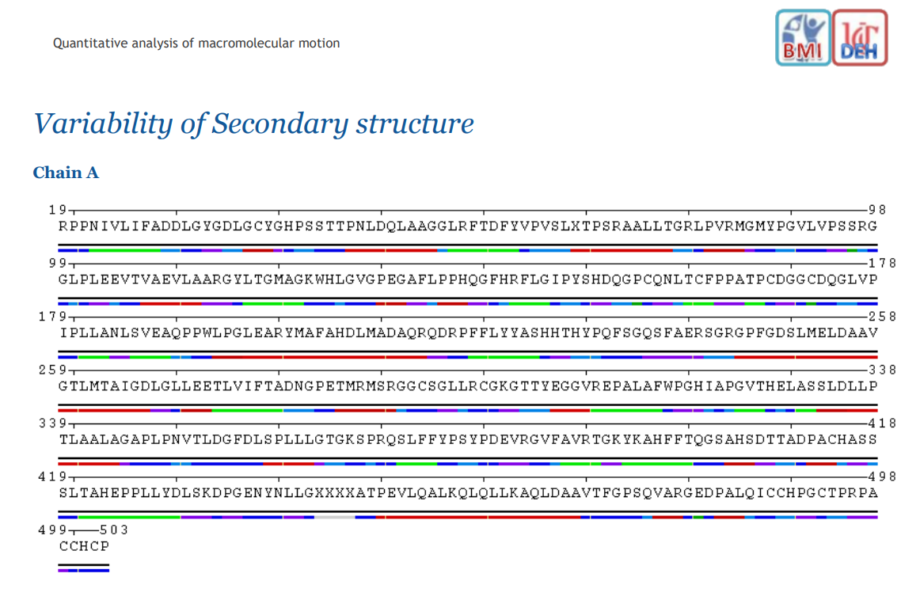
1AUK
T274M

Slide 26
Secondary structure Analysis – POLYVIEW MM
BLUE – Unstructured Loop, Coil
RED – Alpha helix turns
GREEN – Residues in Beta Bridge

Slide 27
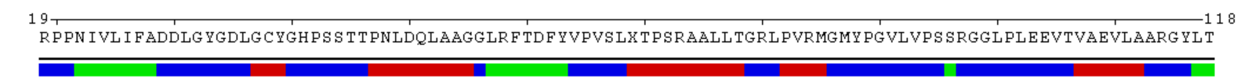
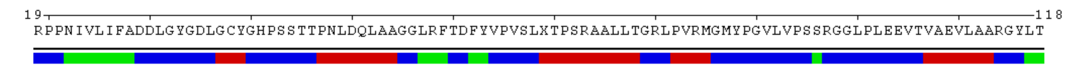
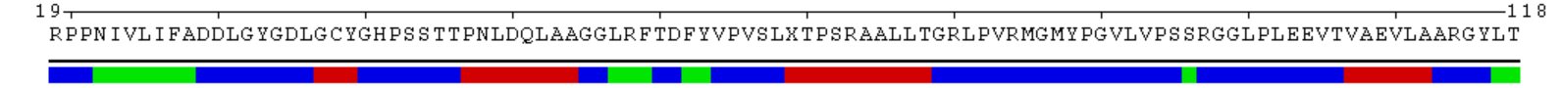
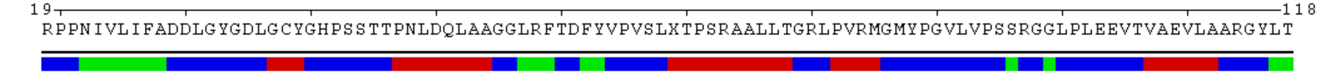
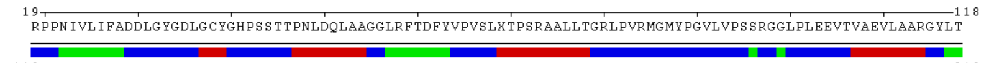
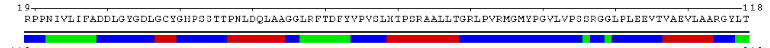
1AUK
T274M
R311Q
R370W
R390W
C489G

Slide 28
Secondary structure Analysis – POLYVIEW MM
Color Code | 1AUK | T274M | R311Q | R370W | R390W | C489G
Unstructured Loop, Coil (Blue) | 52% | 53% | 53% | 53% | 51% | 51%
Residues in Beta Bridges (Green) | 18% | 18% | 18% | 18% | 19% | 20%
Alpha Helix Turn (Red) | 30% | 29% | 29% | 29% | 30% | 29%

Slide 30
Fluctuation Analysis – CABS Flex

Slide 31
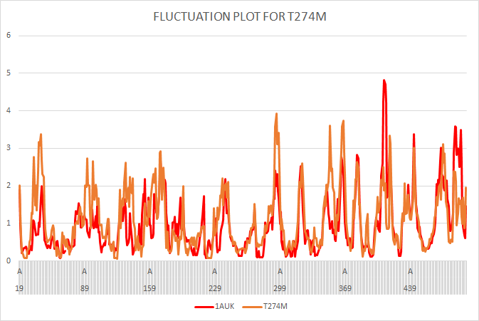
4.8
3.9

Slide 32
Contact Map Analysis – CM View

Slide 33
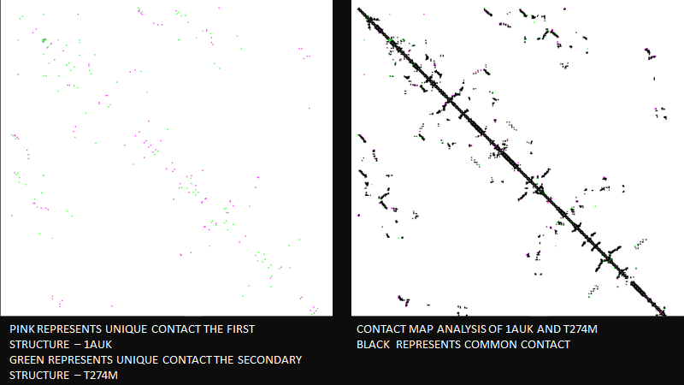

Slide 34
Contact Map Analysis – CM View
Native and Mutants | No. of Contacts | No. of Unique Contacts - NATIVE | No. of Unique Contacts - MUTANTS | No. of Common Contacts | Contact Map Overlap
Native - 1AUK | 2611 | - | - | - | -
T274M | 2608 | 55 | 52 | 2556 | 96.00%
R311Q | 2613 | 54 | 56 | 2557 | 95.90%
R370W | 2602 | 69 | 60 | 2542 | 95.20%
R390W | 2615 | 50 | 54 | 2561 | 96.10%
C489G | 2616 | 48 | 53 | 2563 | 96.20%

Slide 35
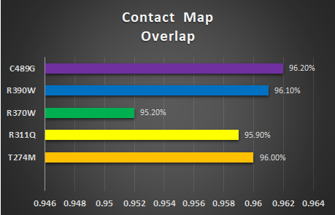

Slide 36
Solvent Accessible Surface Areas (SASA)– GETAREA

Slide 37
Native and Mutants | POLAR area/energy | APOLAR area/energy | Total area/energy
Native - 1AUK | 6131.66 | 11352.01 | 17483.67
T274M | 6141.85 | 11342.84 | 17484.69
R311Q | 6154.04 | 11359.83 | 17513.87
R370W | 6124.73 | 11332.57 | 17457.3
R390W | 6125.6 | 11345.01 | 17470.61
C489G | 6131.61 | 11336.21 | 17467.82
Native and Mutants | Number of surface atoms | Number of buried atoms | Probe Radius
Native - 1AUK | 1822 | 1768 | 1.4
T274M | 1835 | 1756 | 1.4
R311Q | 1841 | 1747 | 1.4
R370W | 1830 | 1763 | 1.4
R390W | 1804 | 1797 | 1.4
C489G | 1799 | 1797 | 1.4

Slide 38
Docking – DockThor/Pymol

Slide 39
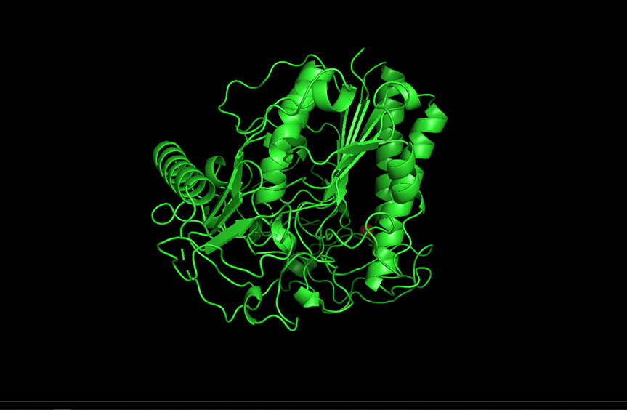
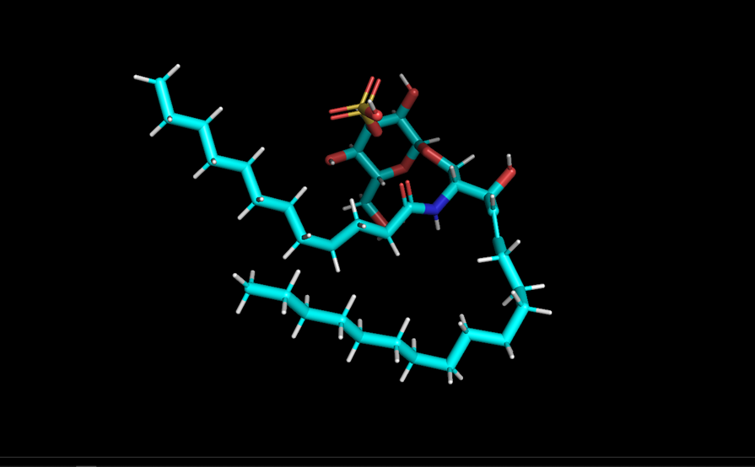
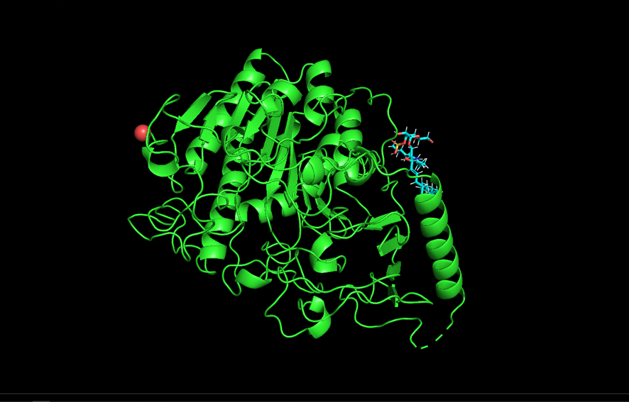
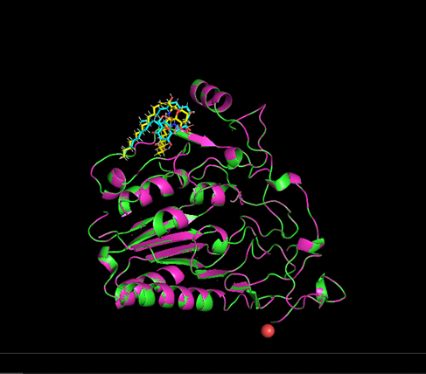
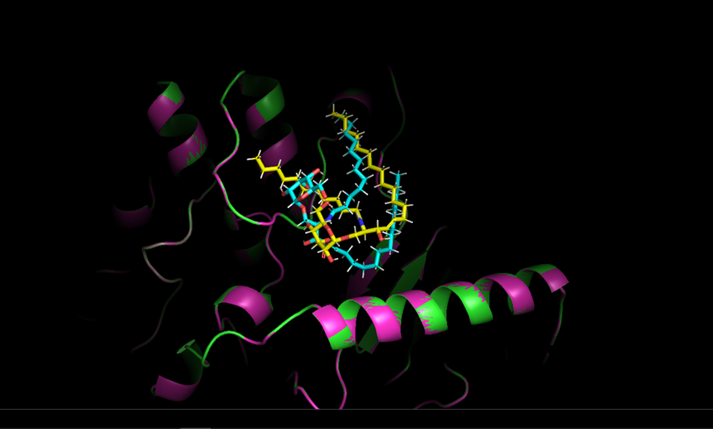
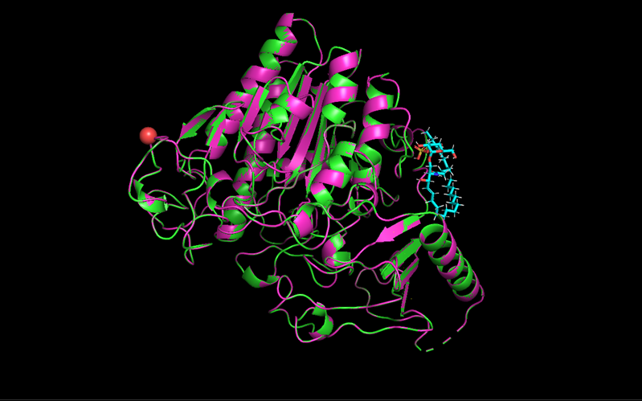

1AUK
LIGAND
DOCKED
DOCKED
T274M

Slide 40
Compounds | Affinity | Total Energy | VDW Energy | Elec. Energy
1AUK | -8.43 | -3.146 | -24.424 | -15.503
T274M | -8.542 | -7.314 | -21.154 | -15.007
R311Q | -8.089 | -2.974 | -25.659 | -10.29
R370W | -8.799 | -3.816 | -26.435 | -9.939
R390W | -7.807 | -3.484 | -20.461 | -10.274
C489G | -8.053 | -8.19 | -28.536 | -6.473

Slide 41
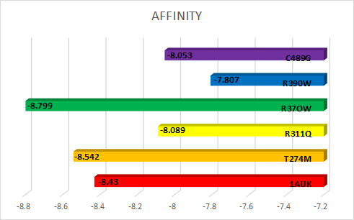

Slide 42
Discussion
Energy minimization was done for the native and the mutant where the Score returned as negative values stating that all compounds are energetically stable.
Further, in single model analysis, under molecular intermolecular interactions, we found that mutations R370W have the highest count of hydrophobic interactions, followed by R390W which means they are more rigid in format compared to the other mutants.
This was followed by the secondary structural analysis where the overall percentage difference between the compounds varied from 1% to 3%, but their end result, was significant.
This was backed up by fluctuations analysis, where the RMSF of residues, continuously varied in comparison with native and every mutant. Under contact map analysis, R370W has the highest number of unique contacts, which was followed up by R311Q, which leads to the least percentage of the contact map overlap.

Slide 43
Discussion
The structural integrity, folding mechanisms, and functional properties of proteins are all known to be influenced by various interactions (Akke & Forsén, 1990). Under SASA analysis. It was found that the number of surface atoms was high, in the native and mutant, except for one mutant C489G, where the no. of buried atoms was the highest, this states that this mutant is more compact than the rest of the compounds.
Further, docking was done for the native and mutant, with the ligand 3-o-sulfogalactosylceramide, where we can visualize how the native superimposed the mutant, and changes in the ligand pose due to these interactions.
Narayanan et al., 2019 states that their research emphasizes the importance of molecular diagnosis in all MLD patients. Thus, we have studied the deleterious mutations that occurred in the ARSA gene, and have produced a qualitative, and structural analysis of the mutant and native, for patients with MLD.

Slide 44
Conclusion
We have demonstrated a comparative molecular study of the deleterious mutants present in the ARSA gene, where various interactions and conformations changes were noted.
These predictions are built on the existing evidence of clinical trials done on MLD patients (Narayanan et al., 2019). Our study on these mutants, emphasizes the significance of genetic research, which is crucial for patients with MLD.
In order to address the diagnostic challenges of MLD, future clinical trials and genetic research is recommended.

Slide 45
REFERENCES
https://jcs.biologists.org/content/132/2/jcs221739.abstract
https://www.ncbi.nlm.nih.gov/pmc/articles/PMC3474616/
https://iubmb.onlinelibrary.wiley.com/doi/epdf/10.1002/iub.284
https://rarediseases.org/rare-diseases/metachromatic-leukodystrophy/
https://my.clevelandclinic.org/health/diseases/17932-hunter-syndrome/management-and-treatment
https://www.researchgate.net/publication/305364762_In_silico_approach_to_explore_the_disruption_in_the_molecular_mechanism_of_human_hyaluronidase_1_by_mutant_E268K_that_directs_Natowicz_syndrome
https://www.genome.gov/geneticsglossary/Lysosome#:~:text=A%20lysosome%20is%20a%20membrane,or%20worn%2Dout%20cell%20parts.&text=If%20the%20cell%20is%20damaged,programmed%20cell%20death%2C%20or%20apoptosis.
https://www.cancertherapyadvisor.com/home/decision-support-in-medicine/pediatrics/lysosomal-storage-diseases/
https://www.researchgate.net/publication/255958134_Cognitive_dysfunction_and_depression_in_Fabry_disease_A_systematic_review
https://molecularcytogenetics.biomedcentral.com/articles/10.1186/1755-8166-7-S1-P53
https://snps.biofold.org/snps-and-go/pages/help.html

Slide 46
THANK YOU

